Slide 1

Customer Churn Analysis
NAME: EMMANUEL ARAOYINBO
ID: W0852664
An analysis of customer churn and strategies to mitigate it

Slide 2
Introduction
This analysis focuses on understanding customer churn in an e-commerce environment, identifying characteristics of customers who have stopped using the service, and providing a marketing strategy to prevent further churn.

Slide 3

Data Overview
The dataset contains features such as Tenure, SatisfactionScore, OrderCount, and more. Missing values were detected in some columns such as Tenure, OrderAmountHikeFromlastYear, and CouponUsed, which require handling during preprocessing.

Slide 4

Data Analysis
The dataset contains features such as tenure, preferred login device, order count, satisfaction score, and more. Data cleaning was performed to handle missing values, and exploratory data analysis was conducted to identify trends related to churn.

Slide 5
Exploratory Data Analysis (EDA)
Descriptive statistics were computed to understand feature distributions. A correlation analysis was performed to identify relationships between variables, highlighting key predictors of churn such as SatisfactionScore and OrderCount.

Slide 6
Key Insights
1. Customers with higher tenure are less likely to churn.
2. Low satisfaction scores are a strong indicator of potential churn.
3. Order count and frequency of engagement play a critical role in churn prediction.

Slide 7
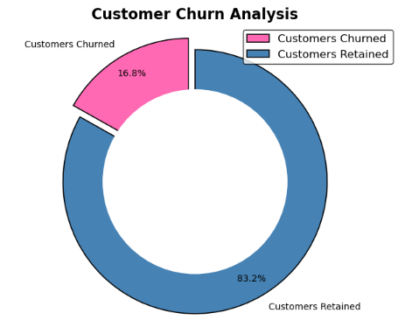

Slide 8
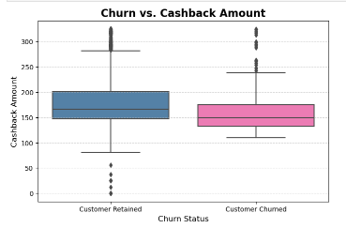

Slide 9

Key Insights from Analysis
Key features influencing churn include SatisfactionScore, OrderCount, and Tenure. Logistic Regression and Decision Tree models performed well, with confusion matrix analysis showing the models' ability to predict churn accurately.

Slide 10
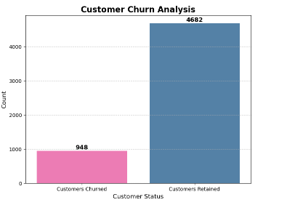

Slide 11
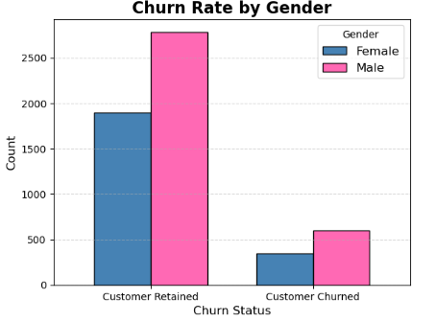

Slide 12
Modeling: Logistic Regression & Decision Tree
Both Logistic Regression and Decision Tree models were used to predict churn. The models were trained using features like SatisfactionScore, OrderCount, and Tenure.

Slide 13

Model Performance: Logistic Regression
Logistic regression was trained to predict churn. The accuracy score was [insert accuracy]. It showed that features like satisfaction score and order count have significant predictive power.

Slide 14

Model Performance: Decision Tree
A decision tree model was also implemented. It showed that decision nodes based on order count and satisfaction score lead to effective churn predictions.

Slide 15
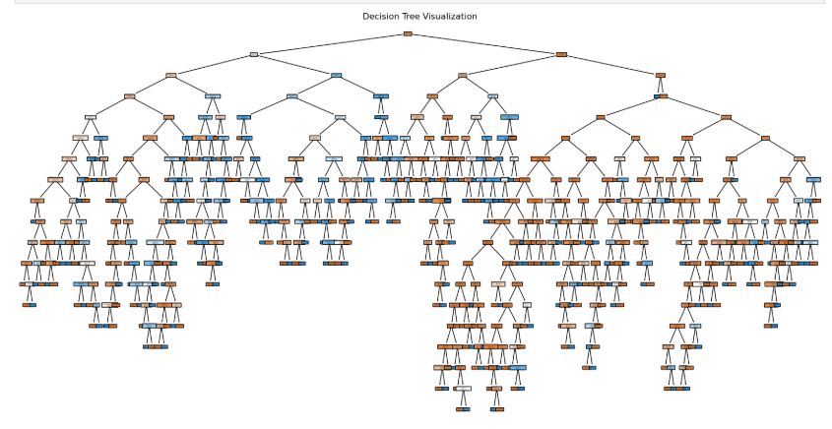

Slide 16

Marketing Strategy
Offer
Offer incentives (e.g., discounts, personalized deals) to customers with low satisfaction scores.
Improve
Improve engagement strategies for customers with high tenure but low order count.
Provide
Provide proactive customer support to at-risk customers.

Slide 17

Confusion Matrix Analysis
The confusion matrices for the Logistic Regression and Decision Tree models are included. These matrices illustrate the models' ability to predict churn vs non-churn customers.

Slide 18
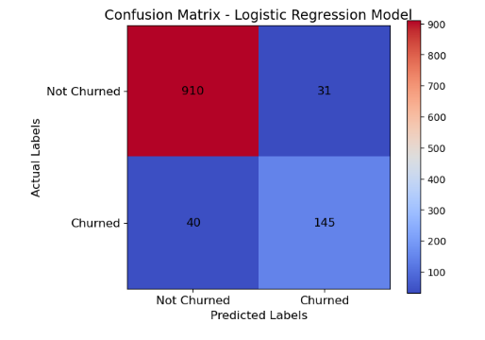
Confusion Matrix - Logistic Regression

Slide 19
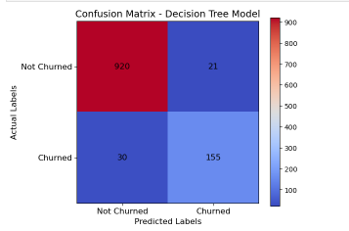

Slide 20

Recommendations for Reducing Churn
Implement targeted retention strategies for high-risk customers identified by the models. Improve data quality by addressing missing values to enhance model accuracy.

Slide 21
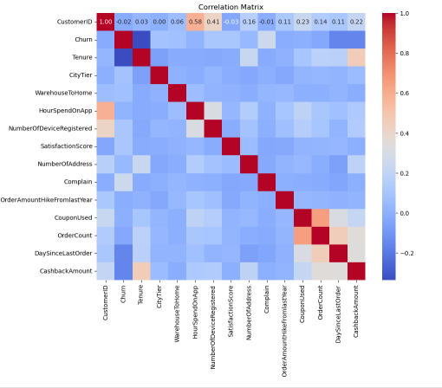
Correlation Heatmap - Key Features

Slide 22
Conclusion
By understanding the key characteristics of churned customers and implementing targeted marketing strategies, businesses can reduce churn and retain valuable customers.

